Slide 1
ECE 313 Final Presentation
Hrishikesh Deshpande (hd11)
Karthik Appana (kappana2)
Siddharth Gummadapu (sg97)

Slide 2
Tasks 1 & 2
Generated PMFs, PDFs, and CDFs for respiratory rate samples (sizes 70, 1000, 30,000) and observed reduced fluctuations with larger sizes (hd11).
Real patient data showed greater deviation from normality (RMSE of 0.9798) than simulated data (RMSE of 0.2468) and had a narrower right-skewed range (kappana2).
Alarms were created using heart, pulse, and respiratory rate thresholds from empirical and normalized distributions (sg97).
Normalized alarms had a lower error probability (0.0160) compared to empirical (0.0327), showing better detection performance (hd11).

Slide 3
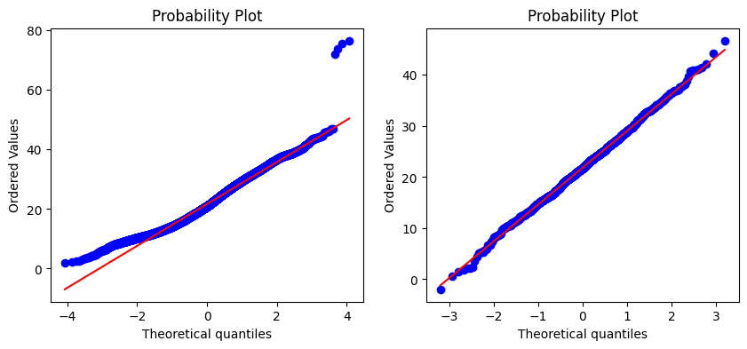
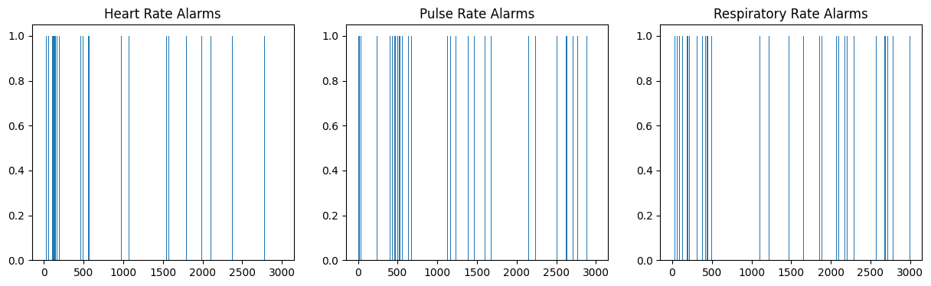

Slide 4
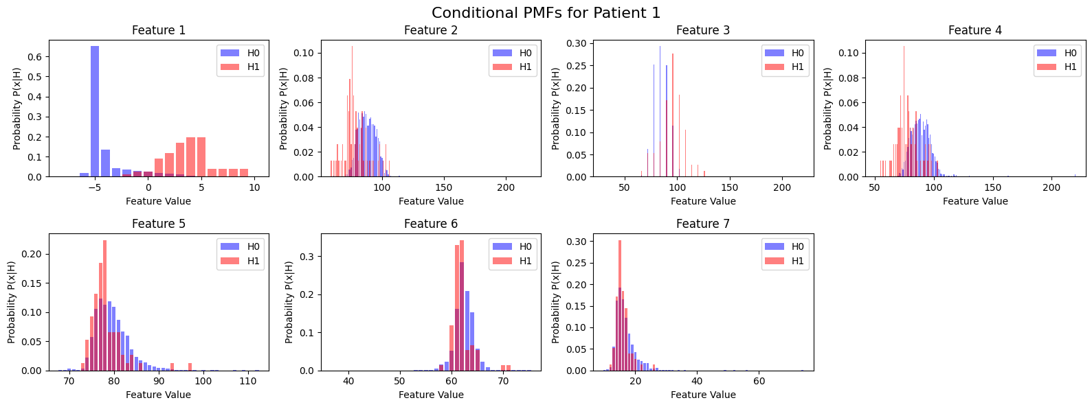
Task 3
Constructed conditional PMFs and likelihood matrices for each of 9 patients (sg97).
Calculated prior probabilities P(H0) and P(H1) for each patient’s training data (sg97).
Built ML and MAP decision vectors from likelihoods and priors (kappana2).
Used false alarm and miss detection rates to compute overall error probabilities (kappana2).

Slide 5
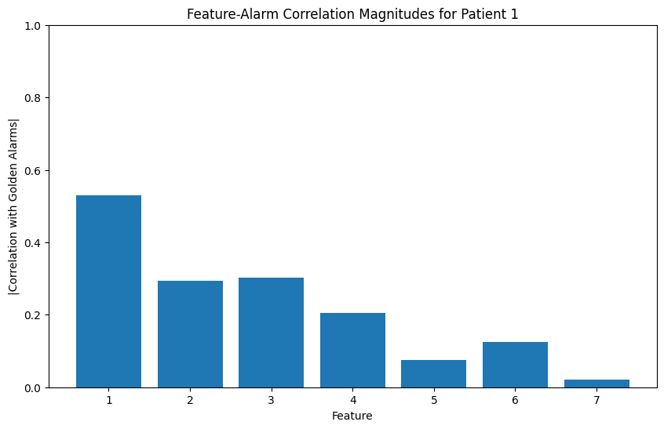
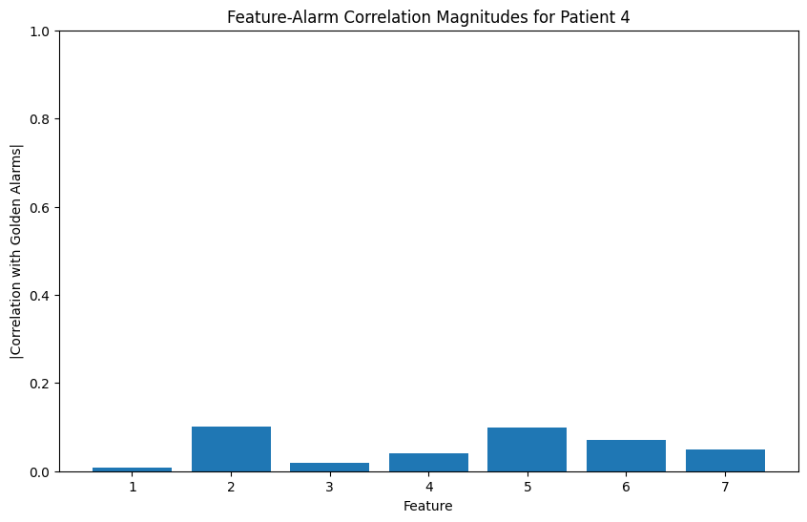
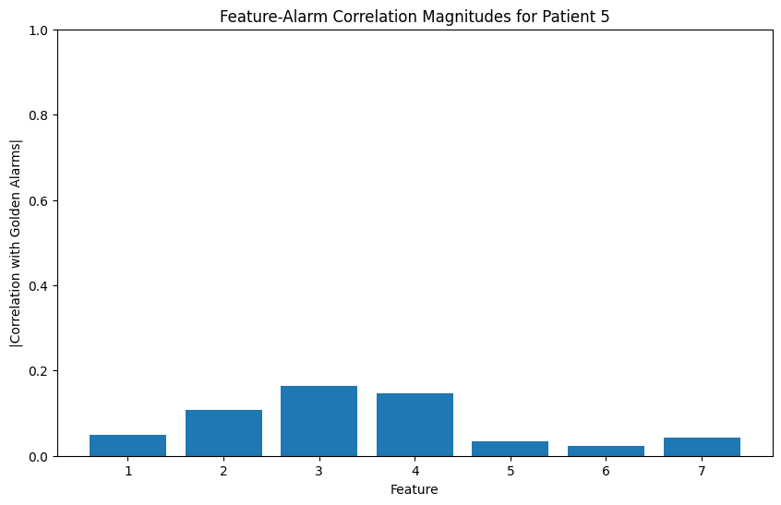
Task 3 - Patient Decisions (hd11)
Patient 1 (ML): Features 1 & 3 chosen due to both low error and high impact (0.0325 error).
Patient 4 (ML): Features 2 & 5 chosen because feature 5 had lowest error and feature 2 provided strong signal correlation (0.0332 error).
Patient 5 (MAP): Features 1 & 3 are the combined best from lowest-error and highest-impact pairs (0.0256 error).

Slide 6
Task 4
Constructed joint likelihood matrices P(X,Y|H0) and P(X,Y|H1) for selected feature pairs (sg97) :
Patient 1: Features 0 & 2
Patient 4: Features 1 & 4
Patient 5: Features 0 & 2
Created joint ML and MAP decision rules using likelihood ratios and class priors (sg97).
Generated predicted alarms for each patient and compared to golden labels (hd11).
Error probabilities were computed for each method and patient (hd11).
Patient | Method | P(FA) | P(MD) | P(E)
Patient 1 | ML | 3.98% | 0.14% | 2.06%
 | MAP | 0.42% | 1.33% | 0.45%
Patient 4 | ML | 3.78% | 0% | 1.89%
 | MAP | 3.78% | 0% | 3.78%
Patient 5 | ML | 3.28% | 0.07% | 1.67%
 | MAP | 0.35% | 0.07% | 0.35%

Slide 7
Task 4
MAP rule outperformed ML in Patients 1 and 5 with lower total error (hd11):
Patient 1: MAP (0.45%) vs. ML (2.06%)
Patient 5: MAP (0.35%) vs. ML (1.67%)
Patient 4 showed worse MAP performance, likely due to skewed priors misaligning with feature distribution (kappana2).
Average Errors (kappana2):
ML Average Error: 1.87%
MAP Average Error: 1.53%
MAP models are more sensitive to prior distribution assumptions but can dramatically reduce false alarms and misses when aligned well (kappana2).

Slide 8
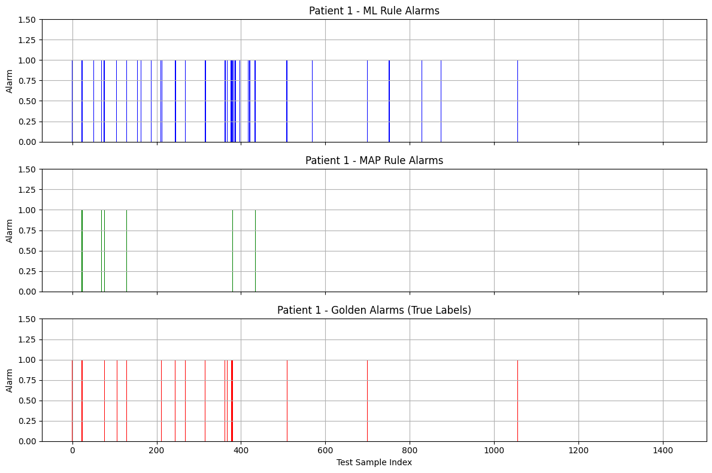

Slide 9
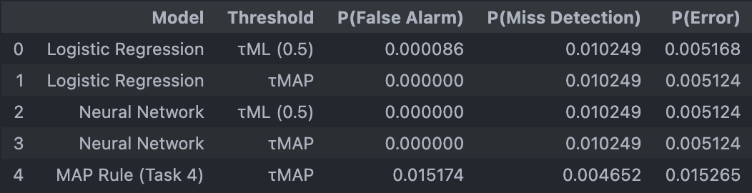
Bonus Task
Built and evaluated Logistic Regression and Neural Network classifiers for alarm prediction (kappana2).
Compared these to the MAP Rule from Task 4 using the same test set across all models (kappana2).
Tested both models with (hd11):
T_ML (0.5) - standard threshold
T_MAP - threshold with class priors

Slide 10
Bonus Task
Both Logistic Regression and Neural Network significantly outperformed the MAP rule from Task 3 in total error rate (sg97).
The MAP Rule had the lowest miss detection rate (0.46%) but suffered from a high false alarm rate (1.52%) (sg97).
Neural Network and MAP Rule delivered the lowest total error (0.51245%) with zero false alarms (hd11).
Incorporating priors via MAP Rule improved all models’ decision boundaries without hurting recall (hd11).

Slide 11
Questions?

